Slide 1

Audio data
Trigger word detection
deeplearning.ai

Slide 2
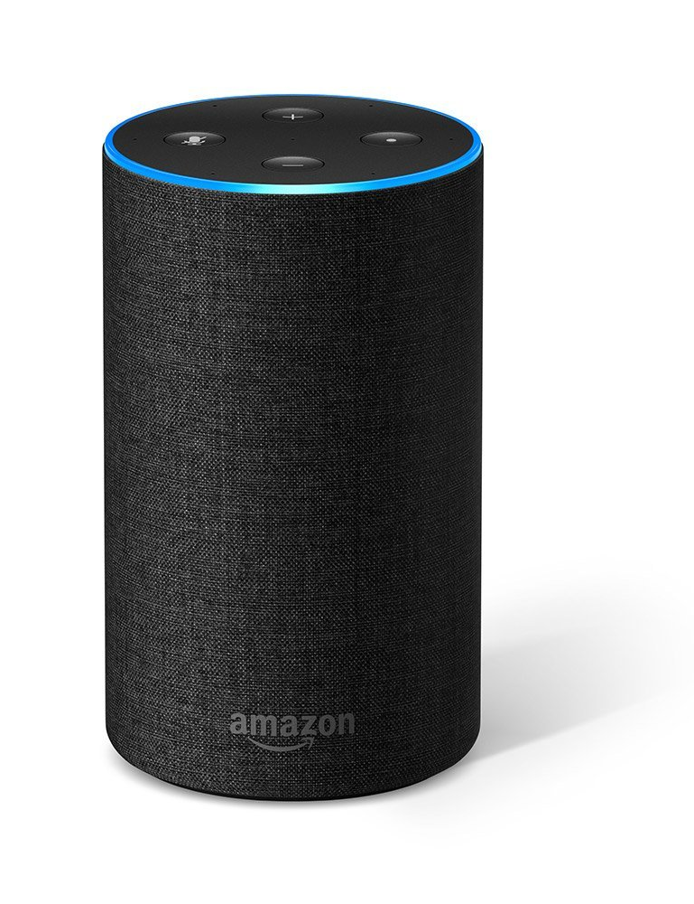

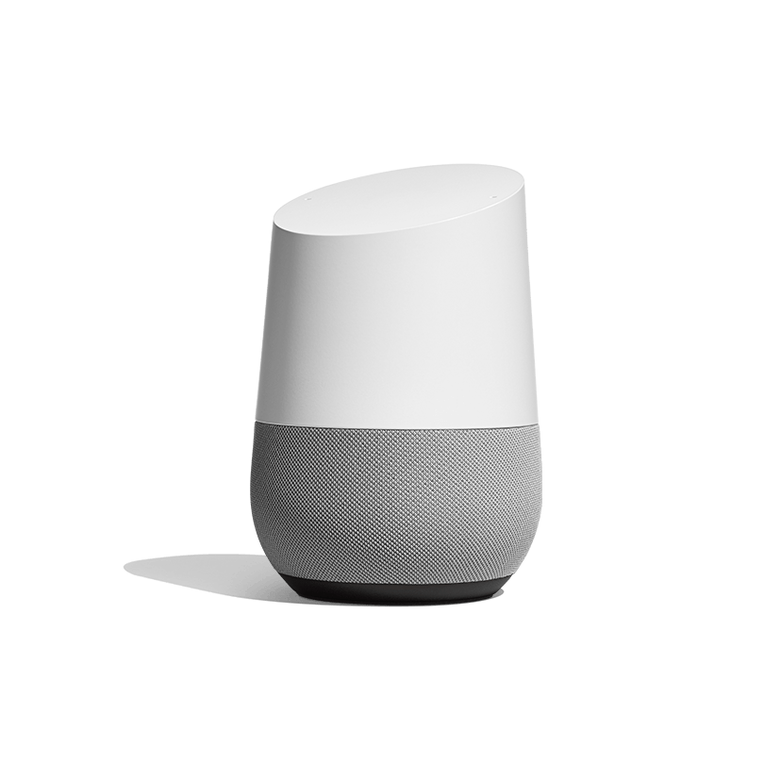
What is trigger word detection?
Amazon Echo
(Alexa)
Baidu DuerOS
(xiaodunihao)
Apple Siri
(Hey Siri)
Google Home
(Okay Google)

Slide 3
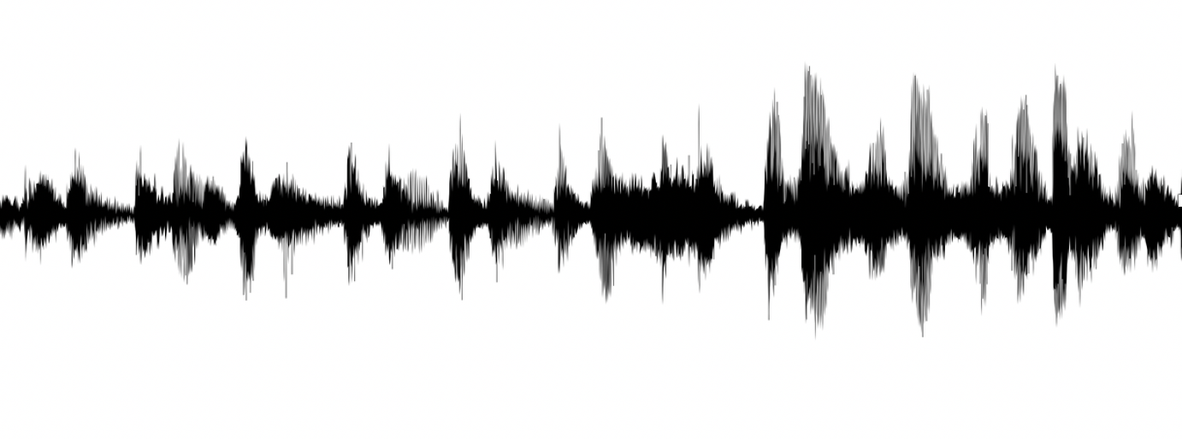




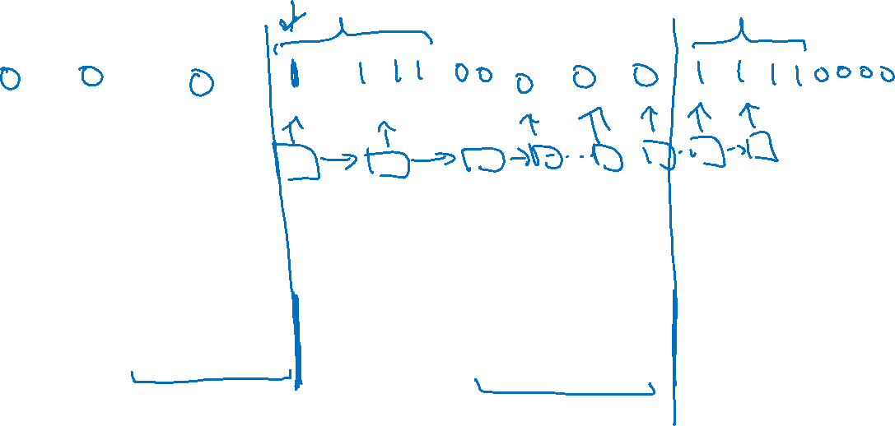
Trigger word detection algorithm
$$a^{<0>}$$
$$x^{<1>}$$
$$x^{<2>}$$
$$x^{<3>}$$

